Slide 1
Big (sequence) data in pharmaceutical R&D
William Spooner, CTO and Founder, Eagle Genomics
©Eagle Genomics Ltd

Slide 2

The dawn of the age of genomic medicine
  The Science
  The Data Deluge
  Pharma’s Challenge
  Eagle’s Response
Image: http://grayninja93.deviantart.com/art/Glow-125681900 CC-BY-NC-ND 3.0

Slide 3

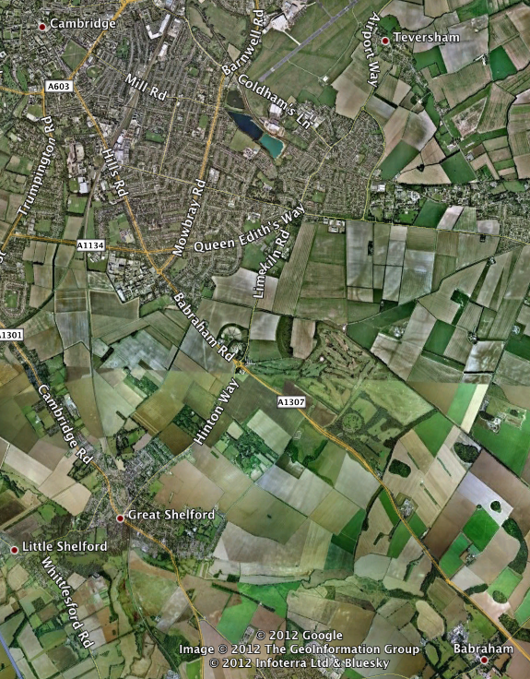
About Eagle Genomics
Babraham-based consultancy
Informatics: life science R&D
Customers in US, Europe, Asia
Operating for 4 years
13 Employees

Slide 4
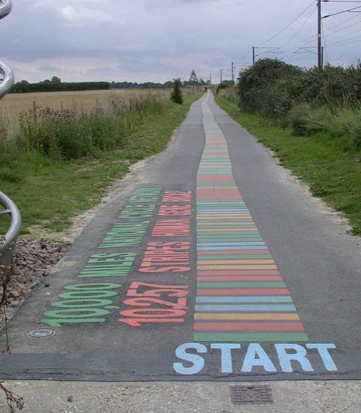
The DNA Path
1 mile
10,000 letters
1 gene; BRCA2
BReast CAncer 2
Tumor suppressor
© Keith Edkins (CC BY-SA 2.0)

Slide 5

The Human Genome
3,000,000,000 letters
20,000 genes
x10 round the world
First sequence (HGP);
Released in 2000
Took 10 years
Cost $100M
© webdesignhot.com (CC SA 3.0)
Notes:
… If the path were to represent all 3 billion letters and 20,000 genes of the human genome at the same scale, it would circle the world ten times.
Remember that we contain this complete instruction set in every single cell in our body!
The sequence was first published in 2000 by the human genome project, which took 10 years.
The cost of the DNA sequencing was well over $100M

Slide 6
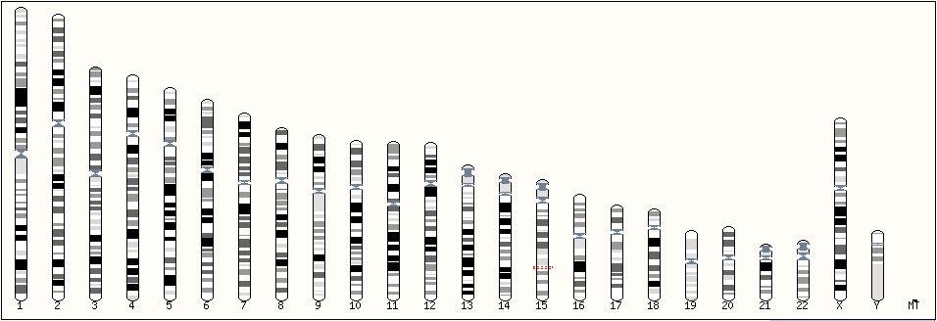
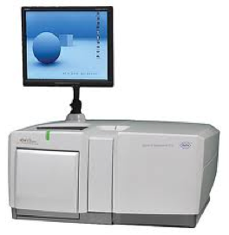
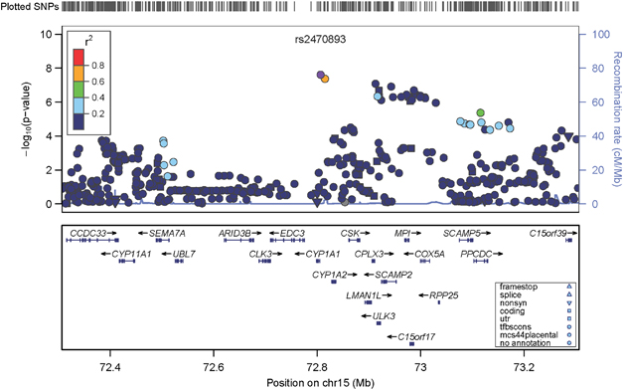
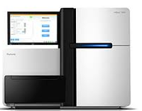
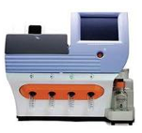

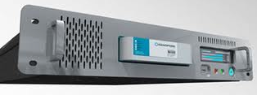
Scientific impact of genomics
Phenotype Association
Image: Sartr http://sartr.deviantart.com/gallery/?offset=96#/d1u0z75 CC BY-NC-ND 3.0
Molecular Psychiatry advance online publication 30 August 2011; doi:10.1038/mp.2011.101

Slide 7


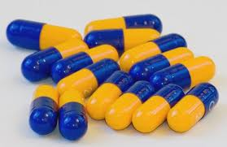
Genomics in pharmacology
Pharmacogenomics
Genotypic
Transcriptomic
Epigenetic
Personalised Medicine
Right drug
Right patient
Right time
Genetic Test
©

Slide 8
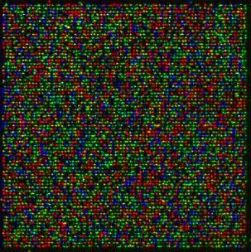
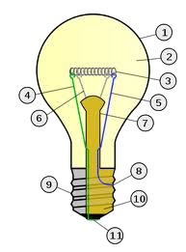
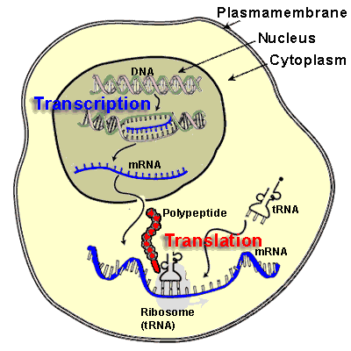
Genomics in disease research

Slide 9

The Data Deluge
Image:http://www.flickr.com/photos/featheredtar/3041846463 CC-BY 2.0

Slide 10
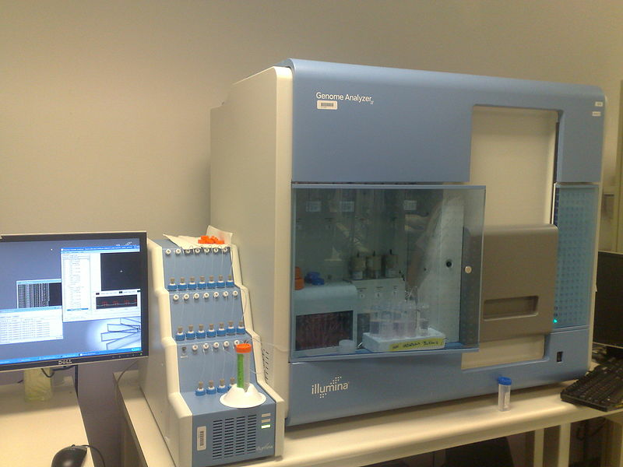

© S. Ballard (CC BY-SA 2.0)
Next Generation DNA Sequencing (NGS)
Latest figures (2012)
Takes 10 days
Costs $10,000
Costs still falling rapidly

Slide 11
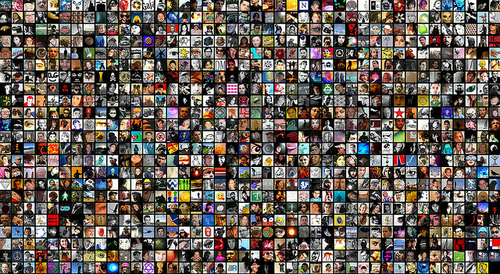
1000 Human Genomes
200 TB sequence data

Slide 12
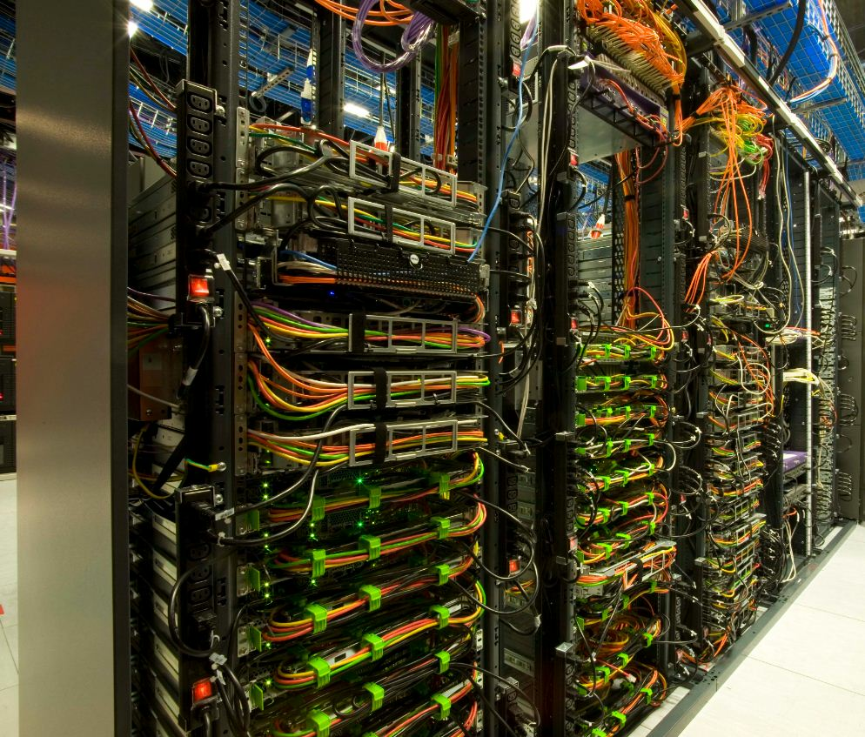
Processing 1000 genomes
© T. Harris
Sanger Institute HPC:
10,000 cores
10 PB storage
Supported by a large team
© Genome Research Ltd.

Slide 13
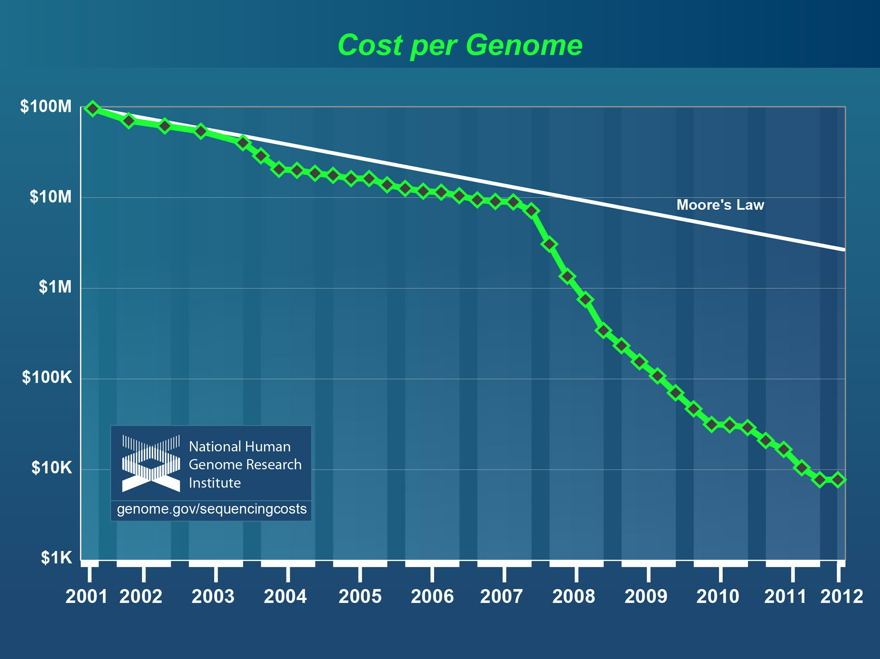
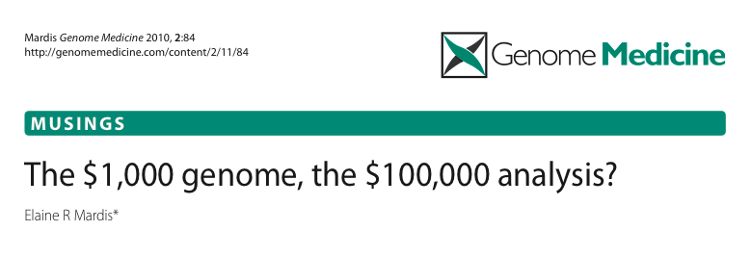
$1000 genome
~$0.01 Mbase (30x coverage)

Slide 14
What causes the analysis bottleneck?
Low Researcher Productivity
Poor Experimental Reproducibility
collection
analysis
reporting
Researcher effort
Progression through experiment

Slide 15

Pharma’s Challenge
Image: Public Domain

Slide 16


Open
Innovation
Collaborate
Enterprise
Academia
Government
Foundations
Explore
Work together to find a common purpose
Nurture
Build trust,
shared
language
Exploit
Turn ideas into
tangible benefits

Slide 17
Sequence Services
Vision for a platform to researchers;
  where they can solve scientific problems
  based on DNA/RNA sequence information
  tailored to the needs of the pharmaceutical industry.
  $50,000 proof-of-concept funding

Slide 18
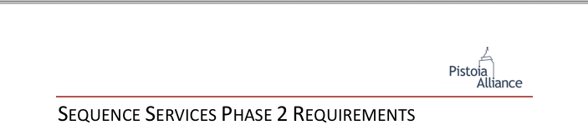
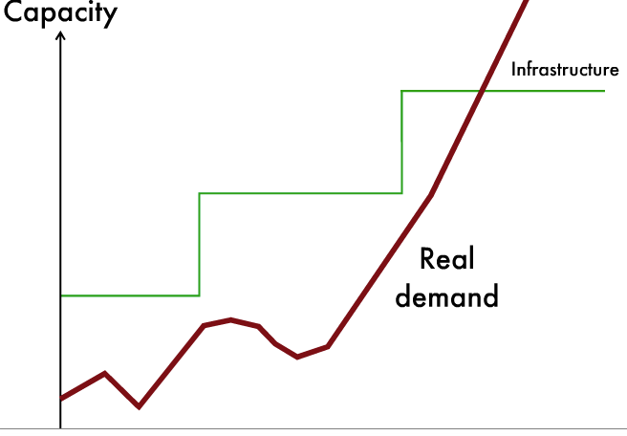
Collaborate securely/easily with other organisations/individuals
  Without any risk to company firewalls.
Secure access to the latest public data and applications,
  Outsource management of rapidly changing resources.
Cost reduction
  Convert capital expense to operational expense.
Store large amounts of data in an extensible way.
  Internal capacity planning cycles are much longer
  than the time over which demand varies.
  Applies equally well to compute as to storage.

Slide 19
Regulation for storage and analysis of DNA data
Data/identity protection/privacy laws;
  Varies between territories,
  Can affects where data must be located.
If genomes = personal health information?
  Mandates compliance with HIPAA
If analyses used in clinical trials?
  Mandates compliance with FDA’s 21 CFR part 11 B
Information security management is key
  Certification, e.g. ISO27001, IASME

Slide 20

Eagle’s Solution
Image: iStockphoto all rights reserved

Slide 21
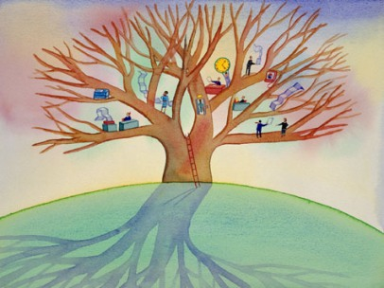
Mission Statement
Researchers need a tool that enables flexible experimental workflows
  Distill, mature, scale, apply, integrate, catalog, and share.
Provide prototype experimental templates
  NOT Fixed sample-centric workflows built around standing research
Provide reusable analytic tools
  NOT Massive, inflexible, automated, analytic “solutions”
Embrace researcher-centric iterative process
  DO NOT Try to take the researcher out of the loop
Image:OpenSeminar.org CC-BY-NC-SA 3.0

Slide 22
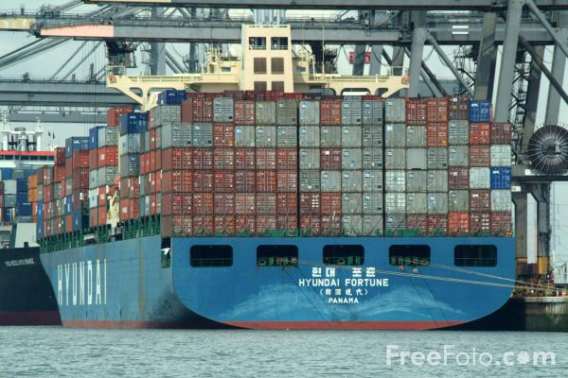

HPC with AWS
Virtual supercomputer
50,000 cores
$5,000/hour
Vs. Hardware cost of:
~$15,000,000
Used for Protein simulation experiment

Slide 23










Slide 24

The platform for storage, analysis and sharing of life sciences data in the cloud

Slide 25
Pistoia Sequence Services Timeline
End - Presentation to Pistoia AGM
ElasticAP implementation starts
Eagle funding round starts
Notification of funding
ElasticAP Beta Release
Proposals Submitted
AT&T ‘ethical hack’
Start - RFP issued
Jul
Aug
Sep
Oct
Nov
Dec
Jan
Feb
Mar
Apr
May
Jun
Jul
Aug
Sep
Oct
2011
2012

Slide 26
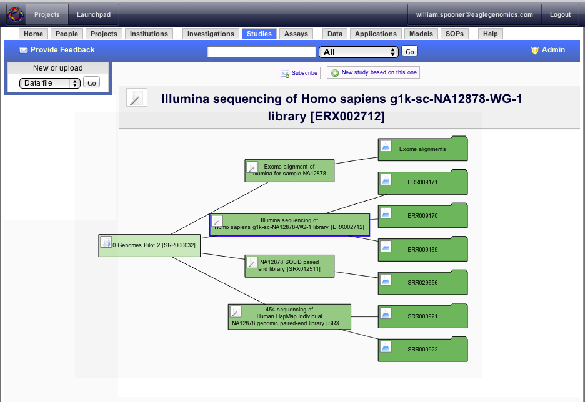




Collaborator
Depositor
Bioinformatician

Slide 27

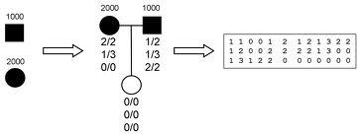
Proof of Concept 1 – Data Scale
The1000 Genomes
A Deep Catalogue of Human Variation
  Freely available on AWS
  1,700 Individuals
  200Tb data
  10,000s data files
  Almost no metadata!
ElasticAP evaluating 1000 Genomes Project Pilot 2
  20X resequencing
  2 trios (6 individuals)

Slide 28
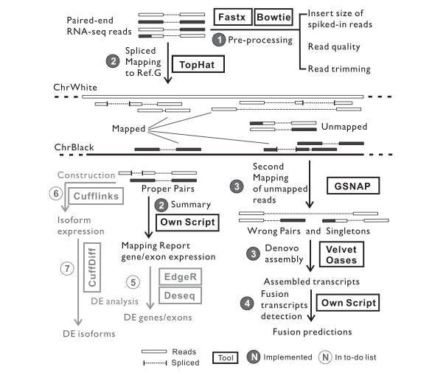
Proof of Concept 2 – Compute Scale
TRUP: Tumor RNA-Seq Unified Pipeline
Exploring cancer mutagenesis
Collaboration between
  Max Planck Institute for Molecular Genetic
  Bayer Pharma AG
Identifies gene fusion events in tumor samples
Pipeline is being implemented on ElasticAP
  Using public GEO datasets for validation

Slide 29
Big data open innovation in Pharma R&D?
Experience from Pistoia sequence services…
Genomic medicine has huge potential, but
  Lots of R&D headaches – the “bioinformatics bathtub”
Inflection point at the move to big data
  opportunity to consider new delivery models
Pharma’s requirements are not unique
  Apply to other areas of pre-competitive big data R&D
Open innovation for Pistoia
  Collaboration improves specification
  Shared development costs
  New approaches are introduced
Open innovation for Eagle
  Pre-validation of opportunity
  Introduction to new partners
  Accelerated product development

Slide 30



info@eaglegenomics.com
www.eaglegenomics.com
+44 (0)1223 654481
facebook.com/eaglegenomics
@wspoonr
@eaglegen
blog.eaglegenomics.com
©Eagle Genomics Ltd
Eagle® is a registered trademark no. 010418135 of Eagle Genomics Ltd.
Postal address: Eagle Genomics Ltd., Babraham Research Campus, Cambridge CB22 3AT, United Kingdom.
Notes:
I’d like to end with the works of Pete Keeley, Unilever’s IT lead for cloud;
“…”

Slide 31
Open Innovation in Open-*
Specification
Development
Product
Open
Source
(Bazaar)
Open
Source
(Cathedral)
Open
Standards
Open
Innovation
Open
Science
Open
Access

